Slide 1
EXPENSES TRACKER

Slide 2
CONTENT:
STRUCTURE OF THE PROJECT
DATAFLOW DIAGRAM
DATA DICTIONARY
FUTURE ENHANCEMENT
USE CASE DIAGRAM

Slide 3
STRUCTURE OF THE PROJECT
MODULES:
A module is a collection of source files and build settings that let you divide your project into discrete units of functionality. Your project can have one or many modules, and one module can use another module as a dependency. You can independently build, test, and debug each module.
The Modules used in this project is as follows:
Login Module
Register Module
Home Page (Introduction to project and features of Project)
View Expenses (table and analytic)
Add Expenses
Logout Module

Slide 4
LOGIN MODULE: This Module is used to enter into the homepage with the authenticated of registered email and password.
REGISTER MODULE: This Module is used to do a new registration for an new user into the application by their name, email, password.
HOME PAGE: This module is used to display the detailed information about the Expense tracker.
VIEWEXPENSES: This module is used to display the list of the Expenses by table and analytic.
ADD EXPENSES: This module is used to add the new expense.
LOGOUT: This module is used to logout for the application.

Slide 5
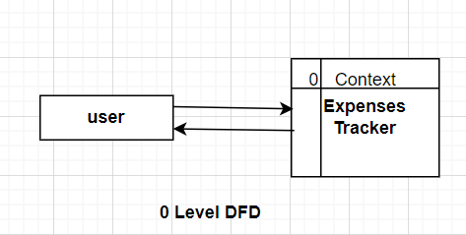
DATA FLOW DIAGRAM

Slide 6
DATA DICTIONARY:
USERS DETAIL TABLE
FIELD NAME | DATA TYPE | DESCRIPTION | CONSTRAINTS
_id | Number | Id, Auto generated | Primary key
name | varchar | Name of the user | Not null
email | varchar | Email of the user | Unique
password | varchar | Login password | Not null

Slide 7
TRANSACTION TABLE
FIELD NAME | DATA TYPE | DESCRIPTION | CONSTRAINTS
id | Number | Id Auto generated | Primary key
userid | varchar | Userid Auto generated
amount | Number | User add amount | Not null
type | varchar | User select income or expense | Not null
category | varchar | User select category | Not null
reference | varchar | User reference | Not null
description | varchar | User description | Not null
date | date | User add date | Not null

Slide 8
FUTURE ENHANCEMENT
Users can directly get a transaction invoice through mail after an adding the expenses or changes in the transaction.
Can automatically track all the expenses of a bank account through the online transaction platform.

Slide 9
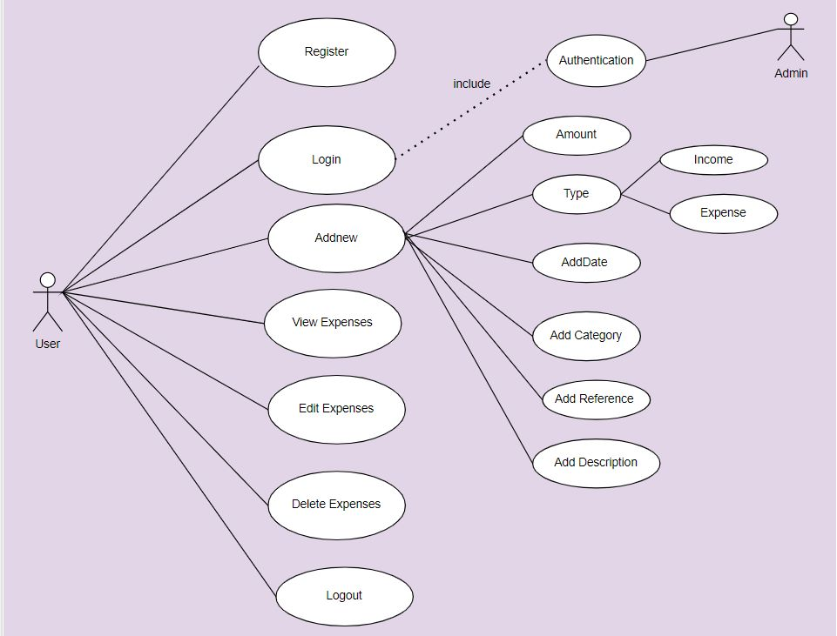
USE CASE DIAGRAM

Slide 10
THANK YOU

